Slide 1
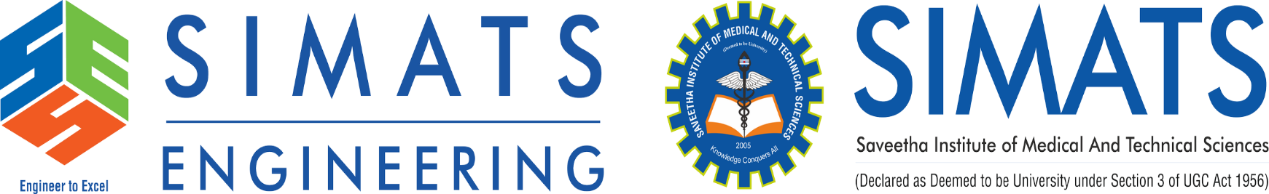
AI-Based Smart Mirror for Real-Time Human Posture Detection and Correction
DSA0216 – Computer Vision with OpenCV for Modern AI
Guided by:
Dr. S. Senthilvadivu
Professor
Dr. T.Kumaragurubaran
Associate Professor
Presented by:
A Ashriktha Reddy (192424172)
K Hasini (192424181)
M Lalitha Sri (192424072)

Slide 2


Abstract
This project proposes an AI-powered smart mirror that uses computer vision to detect and analyze a person’s body posture in real time. A camera captures live video, and pose estimation algorithms identify key body points such as shoulders, elbows, hips, and knees. The system compares the detected posture with correct reference posture data to find mistakes or misalignment. If incorrect posture is detected, the mirror provides instant visual feedback or suggestions to help the user adjust their position. This smart mirror can be used in fitness training, yoga practice, physical therapy, and daily posture improvement to reduce injury risk and improve body alignment.

Slide 3
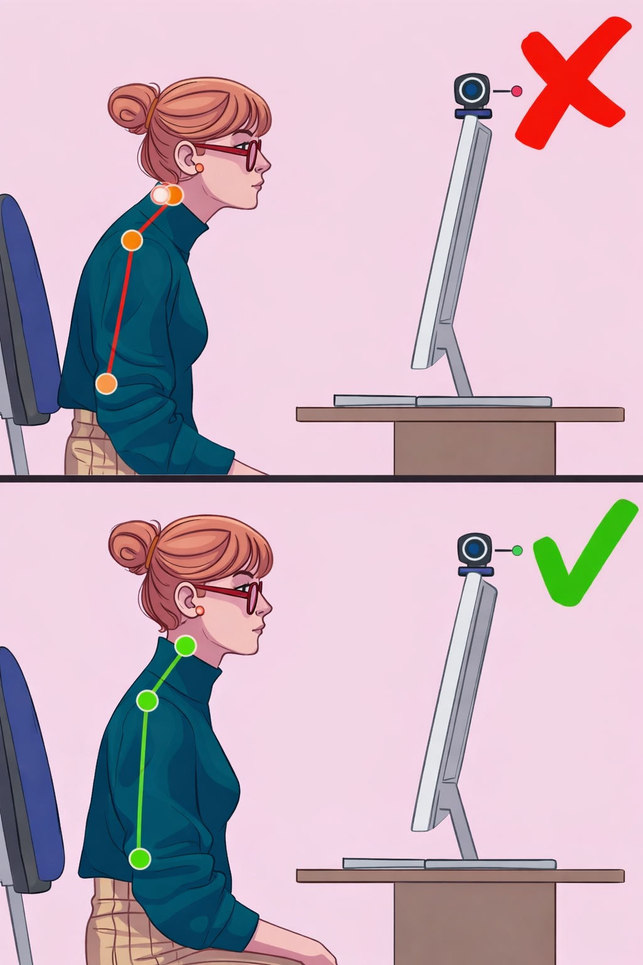
Introduction
The AI Mirror for Real-Time Posture Correction is designed to help users maintain proper body posture during daily activities.
The system uses computer vision to continuously monitor the user’s body position through a camera and analyze posture in real time.
By detecting posture errors and providing timely feedback, it helps improve physical well-being and reduces the risk of posture-related health problems.

Slide 4
Problem Statement
Maintaining proper body posture during long hours of study, work, or screen use is difficult without continuous monitoring.
Existing solutions mostly depend on manual supervision or costly professional equipment, making them unsuitable for everyday users.
Due to lack of real-time awareness, many people develop poor posture habits unknowingly.
There is a need for a low-cost and automated system that can monitor posture continuously.
The system should accurately detect posture deviations in real time and provide immediate feedback for self-correction.

Slide 5
Objectives
To develop an AI-based smart mirror that can monitor human body posture in real time.
To detect key body landmarks such as shoulders, neck, and nose using pose estimation techniques.
To analyze the user’s posture by calculating angles and comparing them with predefined threshold values.
To identify incorrect posture or body misalignment automatically.
To provide instant visual feedback or alerts to help users correct their posture and improve body alignment.

Slide 6
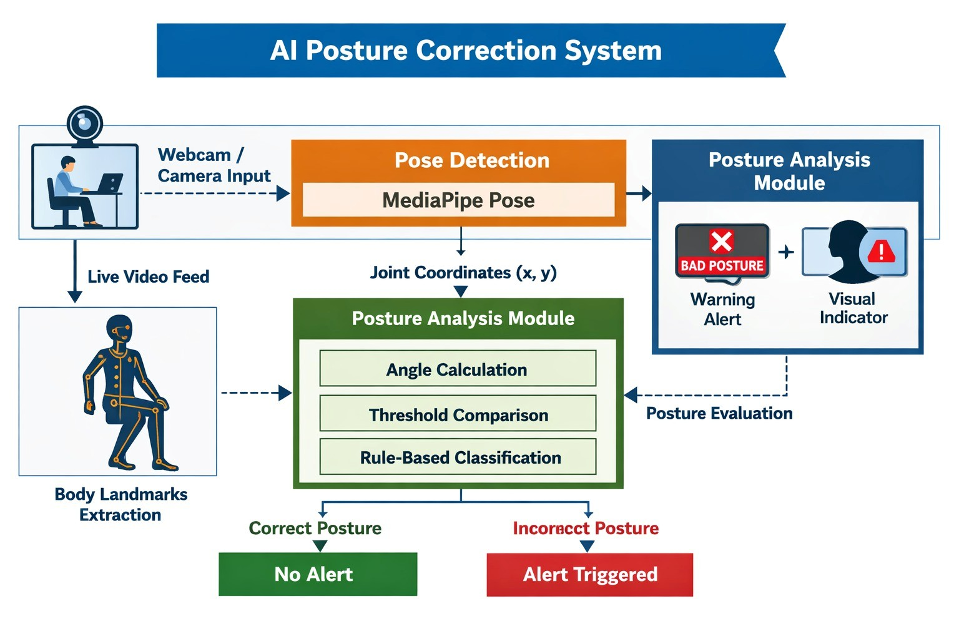
Architecture Diagram

Slide 7
Literature Review​
Author / Year | Title / Source | Key Contribution | Relevance to Current Project | Limitations / Gaps
Amjad et al. (2026) | Real-Time Yoga Pose Estimation Using MediaPipe and SVM (Springer) | Desktop-based real-time pose correction with feedback | Strong support for real-time corrective feedback approach | Focused mainly on yoga poses, not general posture
Bhavani (2025) | NovelHAD Human Posture Detection Using MediaPipe (Cogent Engineering) | Uses MediaPipe landmarks for posture classification | Closely related to our landmark-based posture analysis | Limited real-time user feedback mechanism
Jin et al. (2024) | SitPose: Sitting Posture Detection Using Ensemble Learning (arXiv) | Detects sitting posture and sedentary behavior using depth sensors | Relevant for posture deviation detection in seated scenarios | Requires depth sensor hardware; not low-cost
Li et al. (2025) | LSP-YOLO: Lightweight Sitting Posture Recognition (arXiv) | Lightweight deep model for posture recognition on embedded devices | Shows potential for optimized real-time systems | Uses custom YOLO model; more complex than needed
Roggio et al. (2024) | Analysis of ML Pose Estimation Models (Heliyon) | Comparative study of pose estimation methods for human posture analysis | Validates effectiveness of MediaPipe Pose for posture tracking | Focuses on comparison, not real-time feedback system

Slide 8
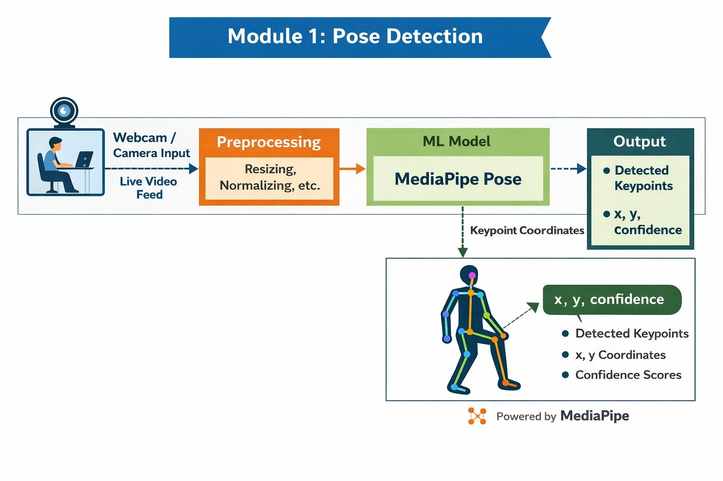
Modules
Module 1: Real-Time Video Acquisition & Pose Detection
Module 1 focuses on capturing live video using a webcam and processing it in real time.
The system analyzes each video frame using pose detection algorithms to identify key body landmarks such as shoulders, elbows, hips, and knees.
These detected points form a digital skeleton model of the user.
This module acts as the foundation of the AI mirror by providing accurate body posture data for further correction and feedback.

Slide 9
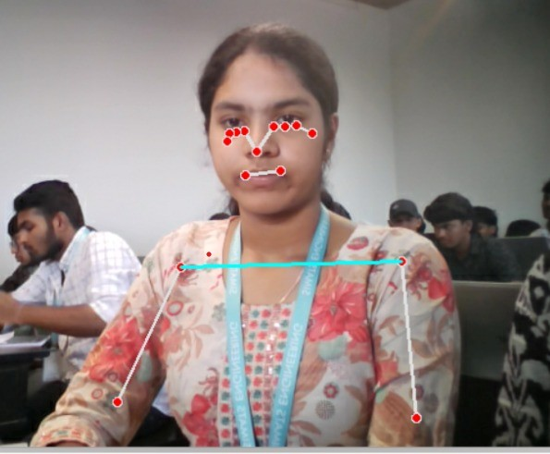
Implementation and Results
The module successfully captured live video from the webcam in real time.
It accurately detected and tracked key body landmarks using the pose estimation model.
The system generated a reliable digital skeleton, providing correct input for further posture analysis.

Slide 10
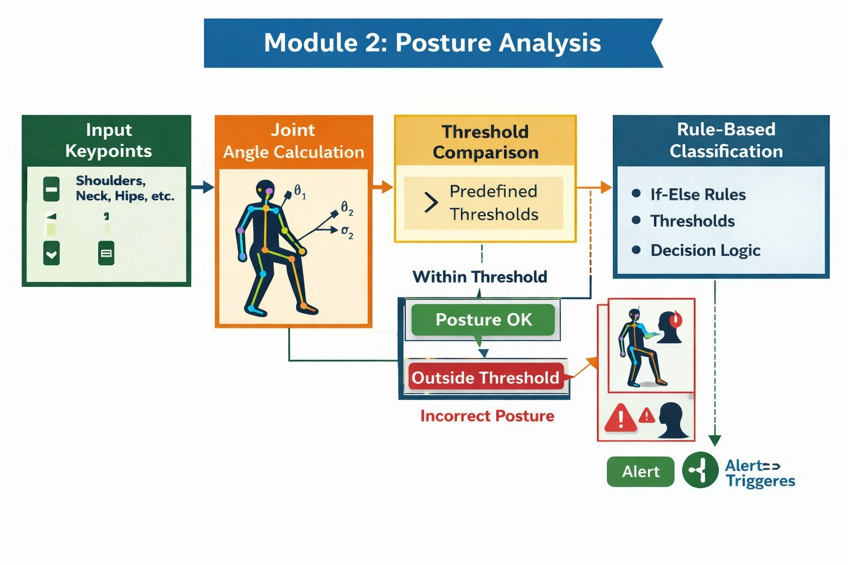
Modules
Module 2: Posture Analysis & Deviation Detection
Module 2 focuses on analyzing the detected body landmarks to evaluate the user’s posture.
The system compares the real-time pose data with predefined correct posture models to identify misalignment or errors.
It calculates angles and distances between key joints to measure deviations.
If any incorrect posture is detected, the system marks the deviation for correction in the next stage.

Slide 11
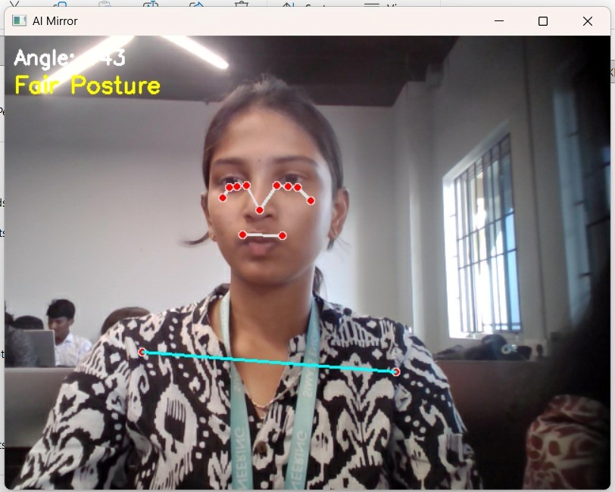
Implementation and Results
The module accurately analyzed body landmarks and calculated joint angles in real time.
It successfully compared the measured values with predefined thresholds to detect posture deviations.
The system reliably identified misalignment and forwarded the results for feedback generation.

Slide 12
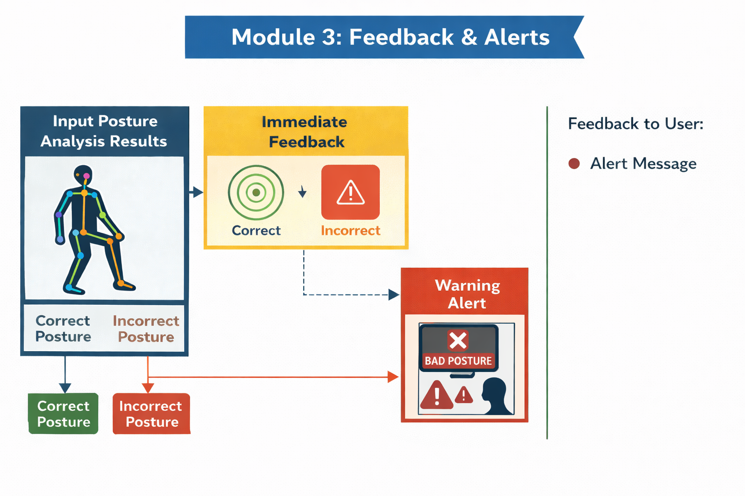
Modules
Module 3: Alert & Feedback System
Module 3 focuses on providing real-time alerts and feedback to the user based on the detected posture deviations.
When incorrect posture is identified, the system generates visual cues, text messages, or audio alerts to guide the user.
The feedback helps the user adjust their body alignment immediately.
This module ensures continuous improvement by making the posture correction process interactive and user-friendly.

Slide 13
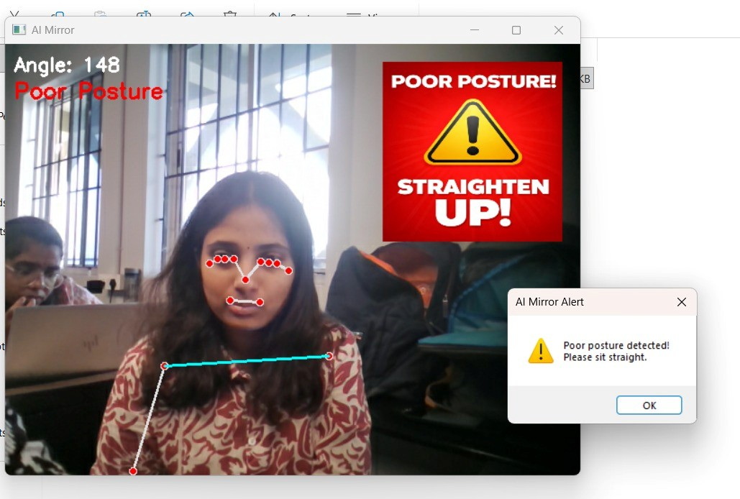
Implementation and Results
The module successfully detected incorrect posture using predefined threshold values.
Real-time visual warning alerts were displayed to help the user correct their posture.
The system worked smoothly and effectively supported immediate posture correction.

Slide 14
Conclusion
The AI Mirror for Real-Time Posture Correction successfully demonstrates how it can be used to monitor and improve human posture automatically. By using real-time video capture and pose estimation, the system is able to detect body misalignment and provide immediate feedback to the user. The proposed solution is low-cost, user-friendly, and suitable for everyday use during study, work. Overall, the project shows that intelligent posture monitoring systems can help reduce posture-related health issues and promote better physical habits through continuous and automated guidance.

Slide 15
Future Scope
Integrate deep learning models to improve posture detection accuracy under different lighting and body positions.
Extend the system to support multiple activities such as yoga pose correction, squat analysis, and exercise monitoring.
Develop a mobile application version for easier accessibility and portability.
Add a posture scoring and progress tracking feature to monitor user improvement over time.

Slide 16
References
Amjad, M. A. Y., Khalid, M., & Wu, H. (2026). Real-Time Yoga Pose Estimation System Using MediaPipe and SVM for Desktop-Based Feedback and Correction. Lecture Notes in Electrical Engineering, Springer.
Bhavani, Y. V. K. D. (2025). NovelHAD algorithm based human posture detection using MediaPipe Pose landmarks. Cogent Engineering.
Li, N., Hao, Z., Wang, Q., & Wang, X. (2025). LSP-YOLO: A Lightweight Single-Stage Network for Sitting Posture Recognition on Embedded Devices. arXiv preprint.

Slide 17
THANK YOU

